Slide 1

Prepared by: Jason Yap
August 2024
Notes:
An association is a voluntary organization dedicated to fighting heart disease and stroke

Slide 2
Why identifying heart disease important?
The project aims to create a predictive model for identifying individuals at high risk of heart disease. By analyzing the key health indicators to build a model capable of predicting heart disease risk.
“Heart disease remains a leading cause of mortality worldwide claiming an estimated over 17 million lives annually (World Health Organization 2024)”, and identifying at-risk individuals is crucial for prevention and early intervention.
Notes:
The Behavioral Risk Factor Surveillance System (BRFSS)
Rephrase to brief

Slide 3




IMPORTANCE OF IDENTIFYING HEART DISEASE RISK
Early Intervention and Prevention: Early detection of heart disease risk indicators can significantly reduce the likelihood of devastating consequences such as heart attacks and strokes.
Personalized Healthcare: By effectively managing and mitigating risk factors, individuals can significantly enhance their quality of life by preventing or delaying the onset of debilitating advanced heart disease.
Economic Benefits: A healthy population is a productive population. By reducing the prevalence of heart disease, we can minimize productivity losses due to illness and disability.
Empowerment and Awareness: Empowering individuals with knowledge about heart disease risks is essential for promoting proactive health management. Increased health literacy encourages individuals to take control of their well-being.
Notes:
An association is a voluntary organization dedicated to fighting heart disease and stroke

Slide 4
1. Understanding Significant Heart Disease Indicators
Source
Project and data assumptions
Indicators brief overview
2. Modeling Development & Insights
3. Actionable Public Health Insights
Three Key Takeaways
Notes:
Heart Risk pros and cons
1.
Respondents Profile like age groups
Variable explanation pros and cons

Slide 5
Key Takeaway 1: Source & Assumptions
Data Source: Originally from Behavioral Risk Factor Surveillance System (BRFSS), processed and posted on Kaggle by the Centers for Disease Control and Prevention.
Assumptions:
The data is accurate, assuming that respondents accurately report their health behaviors, conditions, and demographic details. Misreporting or recall bias could affect the validity of the data.
The sample is represented & consistent with the population: The sample is representative and consistent with the general population.
Linear Relationships when the logistic regression was used.
Independence of Observations: One’s data does not influence another’s within the dataset.
Balance of the Target Variable: Using undersampling techniques.
Association vs. Causation: correlation-related (e.g, if ice cream sales and drowning incident increases, it means both tend to increase)

Slide 6
Key Takeaway 1: Heart Disease Indicators Overview
Variable Insights
Category | Data Variables | Type | Context
Target | HeartDiseaseorAttack | Binary/ Int (1,0) | Experienced HD?
Health Details | HighBP | Binary/ Int (1,0) | HBP confirmed by medical professional?
Health Details | HighChol | Binary/ Int (1,0) | HChol confirmed by medical professional?
Health Details | CholCheck | Binary/ Int (1,0) | Chol check-up w/in 5yrs
Health Details | BMI | Category/ Int (18.5, 24.9, 29.9, 34.9, 40) | Underweight - Obese 3
Health Details | Smoker | Binary/ Int (1,0) | Smoked 100 cigars?
Health Details | Stroke | Binary/ Int (1,0) | Experienced Stroke?
Health Details | Diabetes | Binary/ Int (1,0) | Has diabetes?
Lifestyle | PhysActivity | Binary/ Int (1,0) | Active w/in 30 days? Except work
Lifestyle | Fruits | Binary/ Int (1,0) | Eat 1 or more/ day
Lifestyle | Veggies | Binary/ Int (1,0) | Eat 1 or more/ day
Lifestyle | HvyAlcoholConsump | Binary/ Int (1,0) | Over 14 drink/ week? (7 women)
Access to Healthcare | AnyHealthcare | Binary/ Int (1,0) | Healthcare?
Access to Healthcare | NoDocbcCost | Binary/ Int (1,0) | Avoid medical attention due to cost?
Category | Data Variables | Type | Context
Health Status | GenHlth | Category/ Int (1-5) | 1: Excellent, 5: Poor
Health Status | MentHlth | Int | Days of MentHlth/ Month
Health Status | PhysHlth | Int | Days of PhysHlth/ Month
Health Status | DiffWalk | Binary/ Int (1,0) | Difficulty walking
Personal Details | Sex | Binary/ Int (1,0) | Male/ Female
Personal Details | Age | Category/ Int (1-13) | 1. 18-24, 2. 25-29…13. over 80
Socioeconomic | Education | 1: Only kindergarten, 2-4: Grade - Highschool, 5 : Diploma/ Vocational, 6: Bachelor's Degree | Education levels are varied, with a concentration in higher education
Socioeconomic | Income | 1: Less than $10,0000, 2: $10,0000- $15,00008... 8 : over $75,000, With $5,000 gap. | Income levels are spread across several categories, with distinct peaks

Slide 7
Key Takeaway 1: Heart Disease Indicators Insights
The data has 253,680 observations with 22 features.
Out of 253,680 respondents, 23,893 experienced heart attack or had heart disease.
The community is generally healthy with no who are mostly active and eat healthy foods.
Most do not smoke and consume alcohol heavily.
Low stroke incidence and mostly no diabetes.
Still, there is a considerable number of them do not eat healthy foods.
The community is diverse in terms of age and education levels with a concentration in higher education.
Income levels are spread across several categories, with distinct peaks.
Most have normal BMI, but there are some outliers.
** Insights are from the original data set before downscaling.
Variable Insights

Slide 8
Key Takeaway 2: Development Modeling & Insights
Data Quality
Downscaling
Setting Values
Correlation
Performance Evaluation
Validation & Monitoring
Summaries
Backward Elimination Forward Selection Stepwise Selection
Neural Neuters
Model Comparison
Build & Train Model
Optimization
Feature Selection (RF)
Decision Trees
Gridsearch
Model Assessments (Cross Validation &Logistic Regressions)

Slide 9
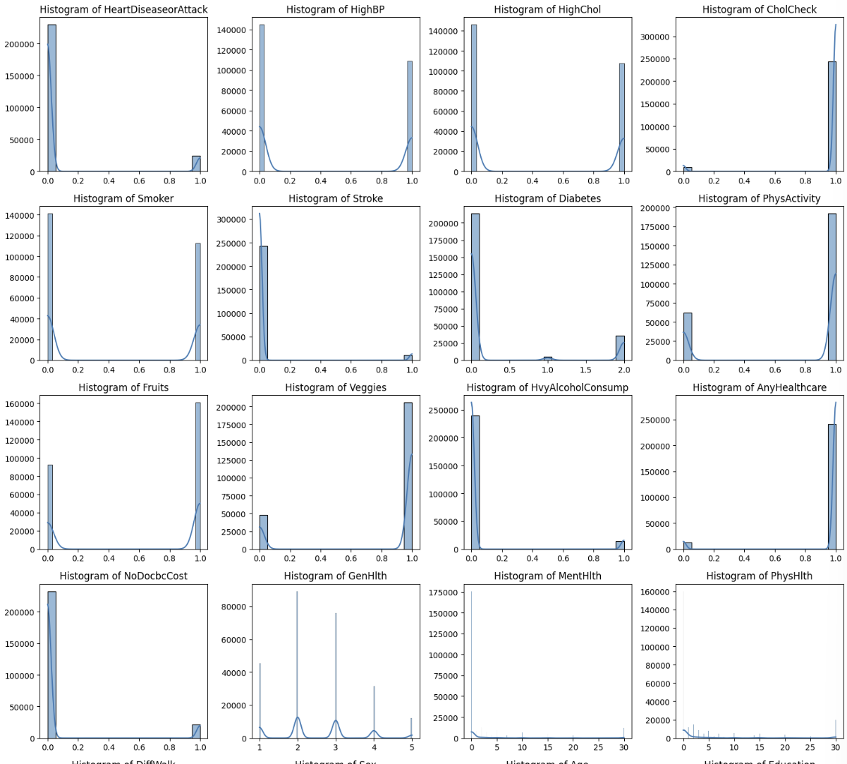
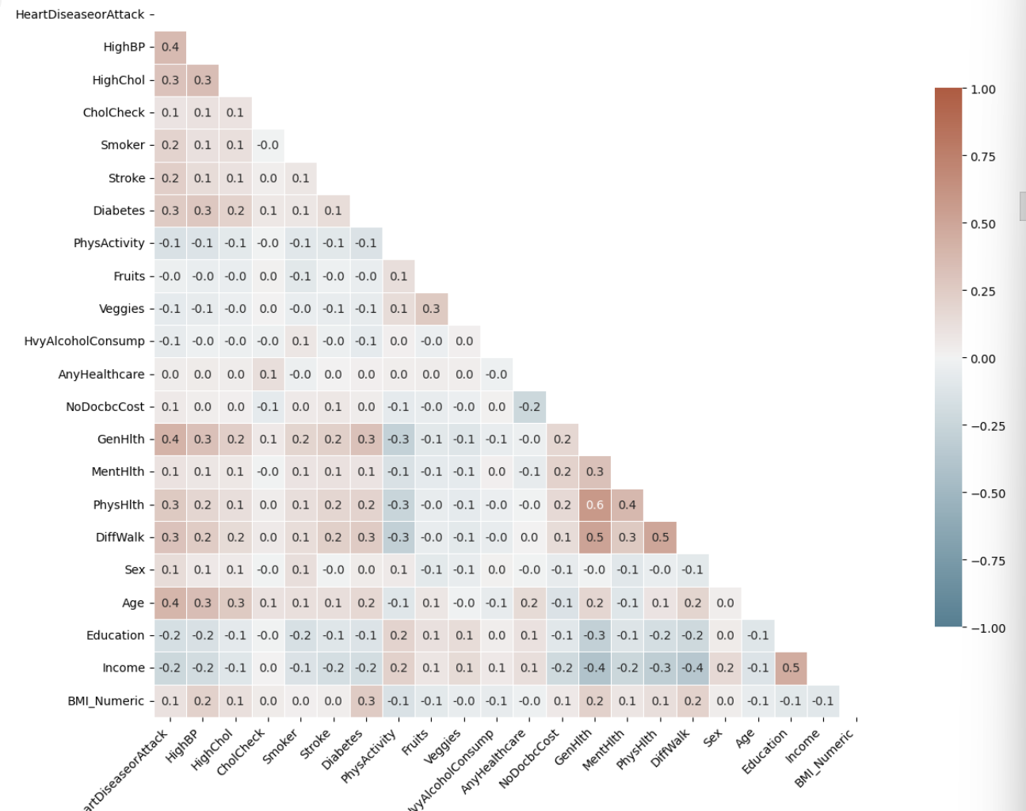
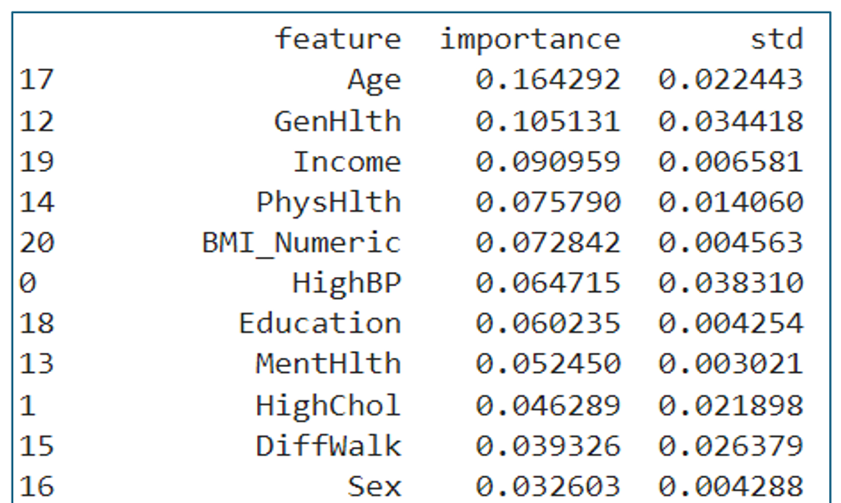
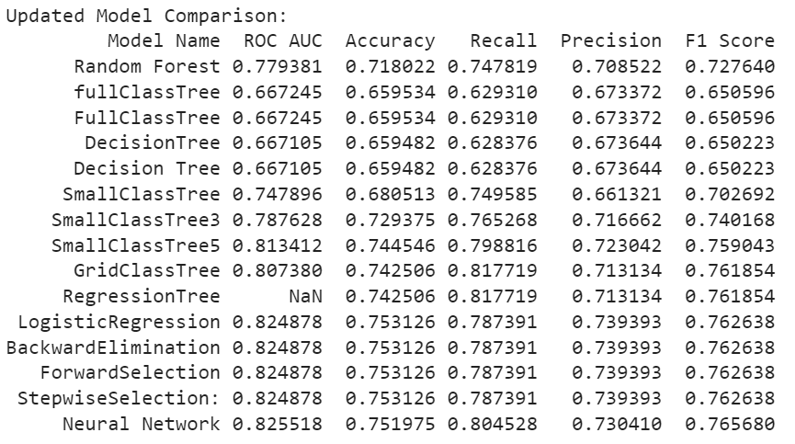
Key Takeaway 2: Process Flow
Variables do not have a significant linear correlation. The highest is 0.6
** Visualization purposes

Slide 10
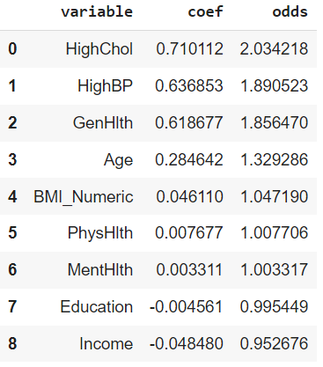
Key Takeaway 2: Development Modeling & Insights
Interpretation:
HighChol: For every 1 confirmed HighChol they are 2x more likely to experience heart disease.
HighBP: Confirmed HighBP is 89% more likely to have heart disease risk.
GenHlth: For every health category increases the more they shall have heart disease risk. (1 – Excellent, 5 Worst)
Age: For every year increases, has a 32% chance of having heart disease risk.
Probability

Slide 11
Key Takeaway 2: Development Modeling & Insights
Neural Network:
ROC: 83%
Accuracy: 75%
Recall/ Sensitivity: 81%
Precision: 73%
F1 Score: 77%
ROC: Best ability to distinguish between classes
Accuracy: Overall good, slightly lower.
Recall: Very good at identifying true positive cases.
Precision: Balanced Correctly
F1 Score: Good balance between precision and recall.
 | Prediction
Actual | No Heart Disease Risk | With Heart Disease Risk
No Heart Disease Risk | 16,687 | 7,206
With Heart Disease Risk | 4,560 | 19,333
Model Comparison Results
Notes:
Components of the Confusion Matrix
True Negatives (TN):
16,687
This is the number of cases where the model correctly predicted "No Heart Disease Risk" when there was actually no heart disease risk.
False Positives (FP):
7,206
This is the number of cases where the model incorrectly predicted "With Heart Disease Risk" when there was actually no heart disease risk. This is also known as a Type I error.
False Negatives (FN):
4,560
This is the number of cases where the model incorrectly predicted "No Heart Disease Risk" when there was actually a heart disease risk. This is known as a Type II error.
True Positives (TP):
19,333
This is the number of cases where the model correctly predicted "With Heart Disease Risk" when there was actually a heart disease risk.

Slide 12
Key Takeaway 2: Development Modeling & Insights
Back Elimination | Forward Selection | Step wise selection
Age GenHlth Income PhysHlth BMI_Numeric HighBP MentHlth HighChol | GenHlth Age HighChol HighBP Income PhysHlth BMI_Numeric MentHlth | GenHlth’ Age HighChol HighBP Income PhysHlth BMI_Numeric MentHlth
Only education was removed, and the rest were deemed as significant by Back, Forward, and Stepwise regressions.
Other Findings: Regression

Slide 13
Key Takeaway 3: Actionable Public Health Insights
Individuals with confirmed high cholesterol and blood pressure, especially those with advanced age and poor health face a significantly elevated risk of heart disease and heart attack.
1. Prioritize Cholesterol Management
Conduct an initiative for widespread cholesterol screening, particularly in communities who has poor health, and are over 55 years old. Comprehensive programs incorporating education, lifestyle guidance, and accessible medication can effectively manage cholesterol levels and reduce heart disease risk.
2. Strengthen Blood Pressure Control Efforts
Same as Cholesterol. Expanding blood pressure screening, coupled with community-based support for sodium reduction, physical activity, and medication access, can help control hypertension and protect heart health.
3. Invest in Overall Well-being and Prevention
Poor General health is strongly linked to increased heart disease risk. Promoting overall well-being through regular check-ups, mental health support, and healthy lifestyle programs can enhance heart health and reduce the burden of heart disease, especially in communities with lower reported health status.
4. Digitalize Heart Risk Survey Questionnaires
For ease and efficient reach, utilize predictive modeling and analytic techniques to create an online survey questionnaire, which could be conducted bi-weekly for the community. To monitor the health altogether.
** Insights are mostly based on an odd ratio since neural networks are difficult to interpret.

Slide 14
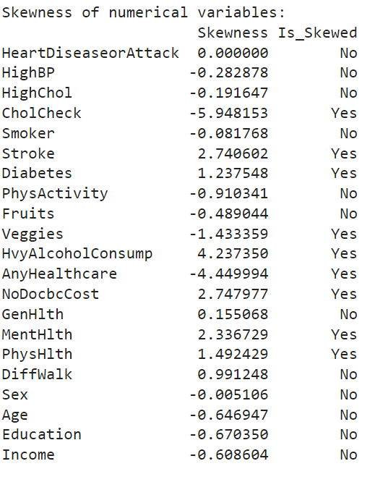
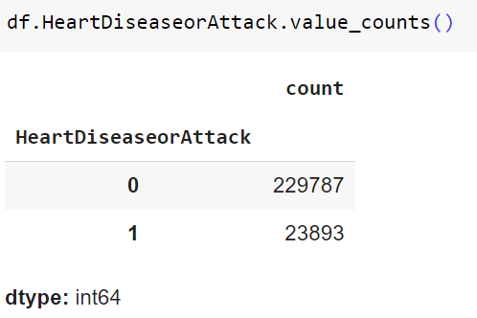
Appendix: Skewness & Target Count
The image shows skewness but there is no need to transform the data because most of them are binary. The only categories are Age, Education, Income, GenHlth, & BMI which are not skewed. In contrast, Phys and Men Hlth are integers.
While the image below shows that most respondents have no heart disease

Slide 15
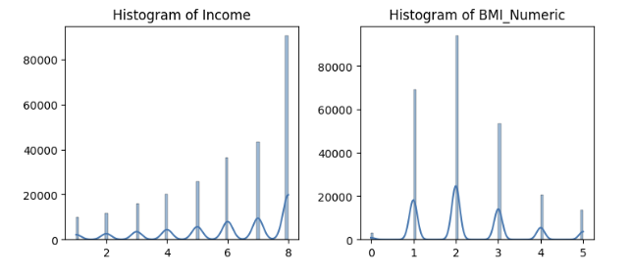
Appendix: Variables Profile
The community is generally healthy but there is a significant number who are not and have vices like smoking or heavy drinking.

Slide 16
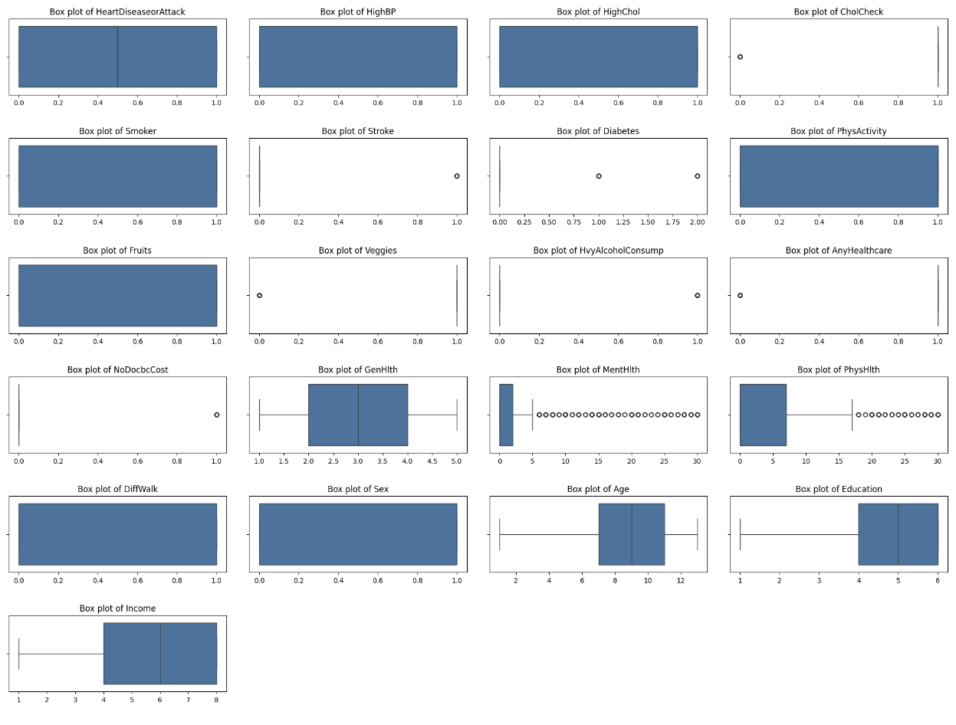
Appendix: Boxplots

Slide 17
Appendix: Heatmap Correlation
Variables show a slight correlation but not significant enough or beyond 0.7. The highest is 0.6 by PhysHlth and GenHlth.

Slide 18
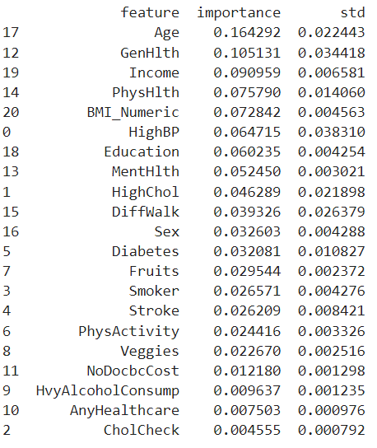
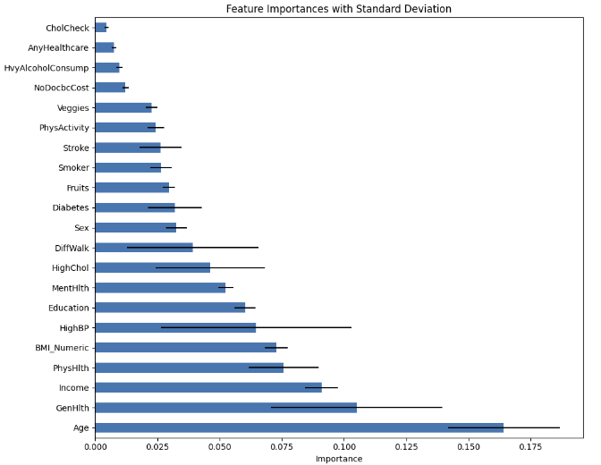
Appendix: Random Forest

Slide 19
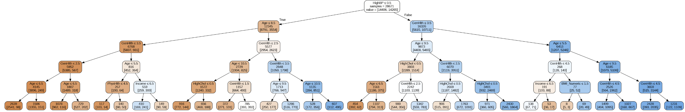
Key Takeaway 2: Development Modeling & Insights
Other Findings: Trees

Slide 20
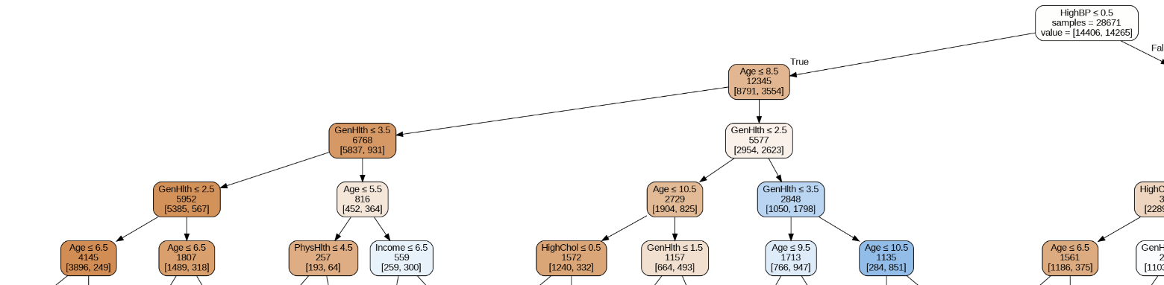
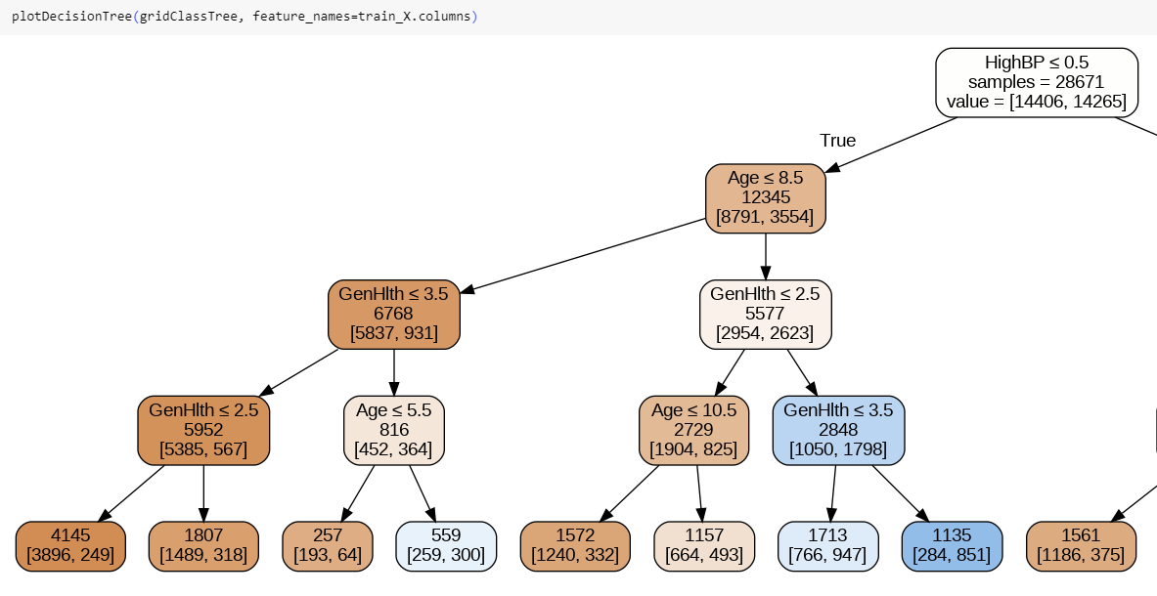
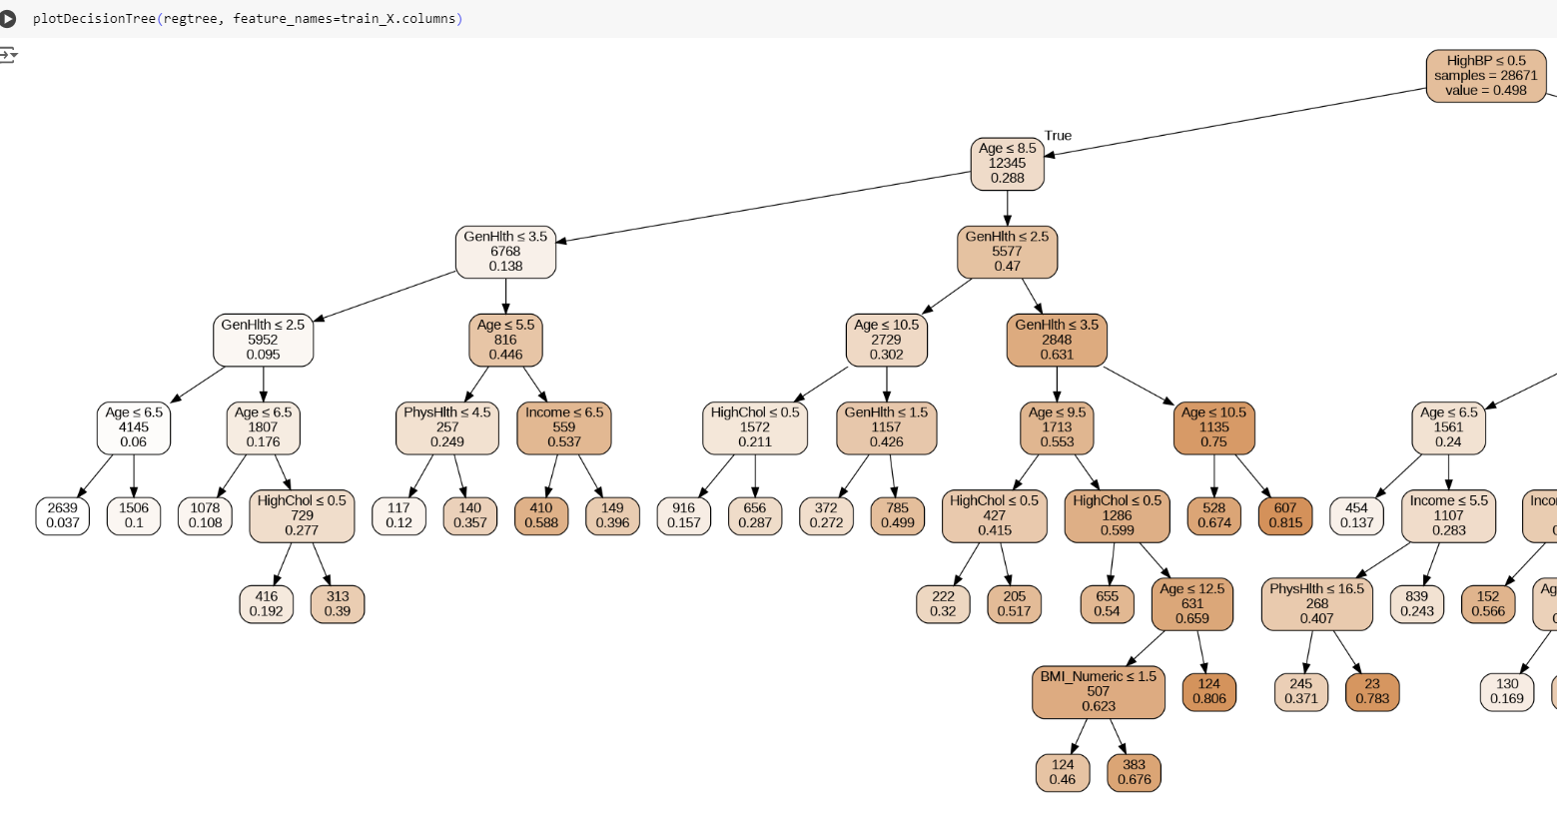
Key Takeaway 2: Development Modeling & Insights
Small Class Tree, Dpt 5
Grid Class Trees
Regression Trees
Images show that respondents who are not confirmed or do not have high BP have a risk of heart disease.
Other Findings: Trees

Slide 21
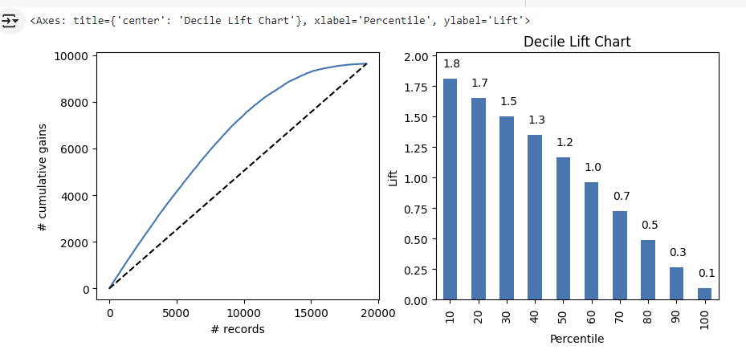
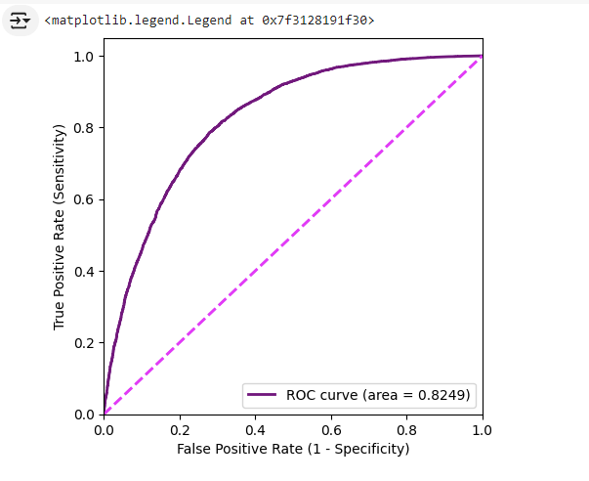
Appendix: Gain Chart
Notes:
Decile Lift Chart: Helps to assess the effectiveness of a model by showing how much better the model performs in identifying positive cases compared to random selection within each decile. A higher lift in the top deciles is desirable.
Gain Chart: Illustrates the cumulative proportion of positive cases captured as you target a higher percentage of the population based on model predictions. A steep initial curve is indicative of a strong model.

Slide 22
Thank You!
Notes:
Decile Lift Chart: Helps to assess the effectiveness of a model by showing how much better the model performs in identifying positive cases compared to random selection within each decile. A higher lift in the top deciles is desirable.
Gain Chart: Illustrates the cumulative proportion of positive cases captured as you target a higher percentage of the population based on model predictions. A steep initial curve is indicative of a strong model.

